Slide 1


ROYAL UNIVERSITY
OF PHNOM PENH
IC: Chapter 3b
Public-Key Cryptography and Message Authentication
Secure Hash Algorithm-512 (SHA-512)
25 March 2022 by Lecturer Chap Chanpiseth

Slide 2
Outline
SHA-512 overview
processing of SHA-512
word expansion
compression function
round function
additive constants
applications
cryptanalysis

Slide 3
Overview
Developed by National Institute of Standards and Technology
Member of SHA-2 family consists of six hash function with digest (hash values) 244 bits: SHA-244, 256 bits: SHA-256, or 512 bits: SHA-512
Maximum message size 2¹²⁸-1 bits (340 undecillion 3.40e + 38)
Block size 1024 bits
Message digest size 512 bits
Number of rounds 80
Word size 64 bits
Notes:
Types of active attacks: In a masquerade attack, the intruder pretends to be a particular user of a system to gain access or to gain greater privileges than they are authorized for.

Slide 4
Overview of SHA-512
Input Message
SHA 512
Hash Value - 512

Slide 5
Overview of SHA-512
Input Message
Padding
SHA 512
M1: 1024 bits
M2: 1024 bits
M3: 1024 bits

Slide 6
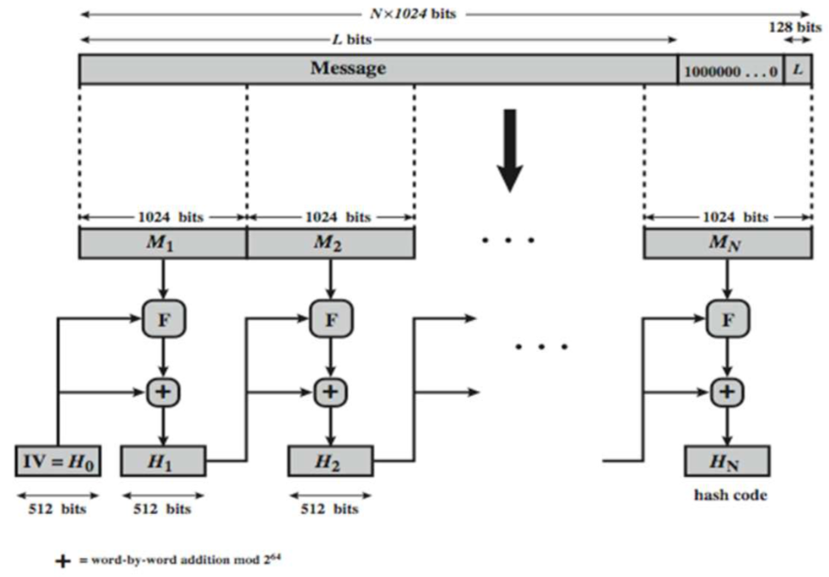
Processing of SHA-512
Figure: SHA-512 Processing of a Single 1024-Bit Block

Slide 7
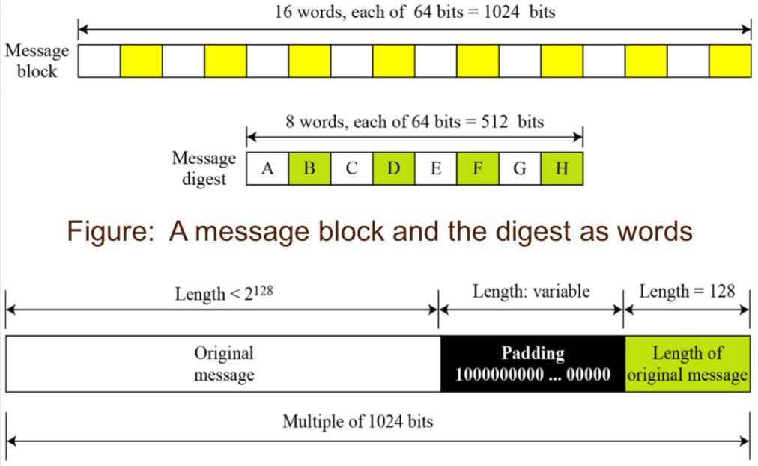
Message block and digest word
Figure: Padding and length field

Slide 8
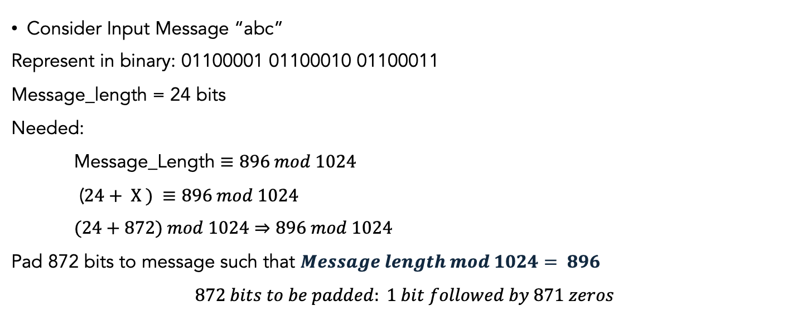
Padding Example
Consider Input Message “abc”
Represent in binary: 01100001 01100010 01100011
Message_length = 24 bits
Needed:
Message_Length $≡896 mod 1024$
($24+ X ) ≡896 mod 1024$
$(24+872) mod 1024⇒896 mod 1024$
Pad 872 bits to message such that $Message length mod 1024= 896$
$$872 bits to be padded: 1 bit followed by 871 zeros$$

Slide 9
Padding Example
[6162638000000000 00000000000000000 00000000000000000 00000000000000000
00000000000000000 00000000000000000 00000000000000000 00000000000000000
00000000000000000 00000000000000000 00000000000000000 00000000000000000
00000000000000000 00000000000000000] => only 896 bits
Pad the original length of the message for 128 bits at the end;
01100001 01100010 01100011 => Message_Lenght=24 bits => Decimal value 24 = Hexadecimal value 18
00000000000000000 00000000000000018
61626380000000000 00000000000000000 00000000000000000 00000000000000000
00000000000000000 00000000000000000 00000000000000000 00000000000000000
00000000000000000 00000000000000000 00000000000000000 00000000000000000
00000000000000000 00000000000000000 00000000000000000 00000000000000018

Slide 10
Padding Exercise
How many bits you will pad for input message length of 2348 bits?

Slide 11
Processing of SHA-512
Appending padding and fixed 128 bit length field
Dividing the augmented message into blocks
Using a 64-bit word derived from the current message block
Using 8 constants based on square root of first 8 prime numbers (2-19)
2, 3, 5, 7, 11, 13, 17 and 19
Updating a 512-bit buffer
Using a round constant based on cube root of first 80 prime numbers (2-409)
2, 3, 5, 7, 11, 13, 17, 19, 23, 29, 31, 37, 41, 43, 47, 53, 59, 61, 67, 71, 73, 79, 83, 89, 97, 101, 103, 107, 109, 113, 127, 131, 137, 139, 149, 151, 157, 163, 167, 173, 179, 181, 191, 193, 197, 199, 211, 223, 227, 229, 233, 239, 241, 251, 257, 263, 269, 271, 277, 281, 283, 293, 307, 311, 313, 317, 331, 337, 347, 349, 353, 359, 367, 373, 379, 383, 389, 397, 401, 409

Slide 12

Message block and digest word
Operates on words
Each block consists of $sixteen 64 bits(1024 bits) words$
Message digest has $eight 64 bits (512 bits) words$named A,B,C,D,E,F,G,H
$Expanding 80 words from sixteen 64 bits words$

Slide 13
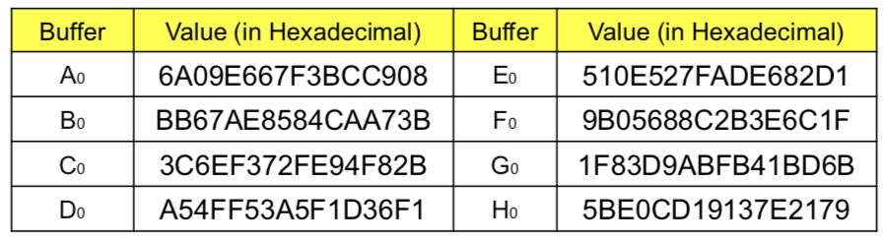
SHA-512 Initial Values & Word Expansion
Table : Initial Values defined Values of constants in message digest initialization of SHA-512

Slide 14
Calculation of constants
For example,
The 8th prime is 19, with the square root (19)^{1/2}= 4.35889894354 Converting this number to binary with only 64 bits in the fraction part, we get,
The fraction part ∶ (5𝐵𝐸0𝐶𝐷19137𝐸2179)₁₆
The 80th prime is 409, with the cubic root (409)^{1/3} = 7.42291412044. Converting this number to binary with only 64 bits in the fraction part, we get
The fraction part: (6C44198C4A475817)₁₆
(100.0101 1011 1110 ...1001)₂ -> (4.5𝐵𝐸0𝐶𝐷19137𝐸2179)₁₆

Slide 15
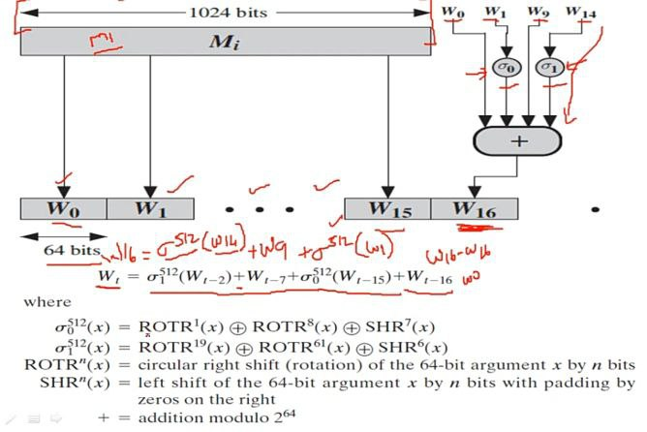
SHA-512 Initial Values & Word Expansion (Cont.)
right shift
Figure: How to derive 80 words from a block of 1024 bits

Slide 16
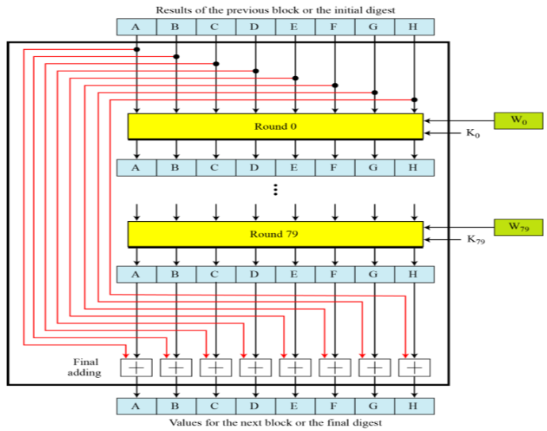
SHA-512 Compression Function
Figure: Compression Function in SHA-512

Slide 17
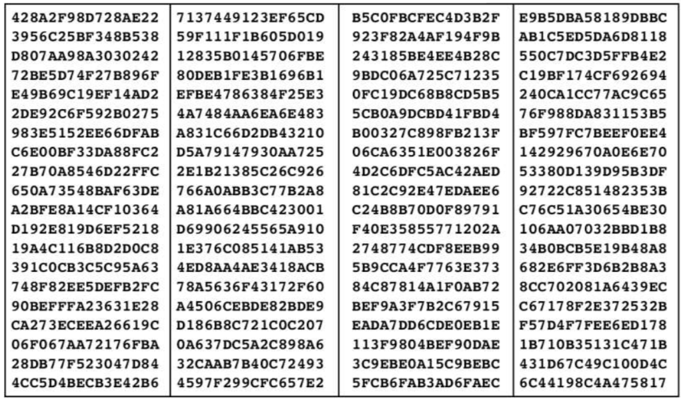
SHA-512 Round constants (K)
Figure: List of round constants used in SHA-512

Slide 18
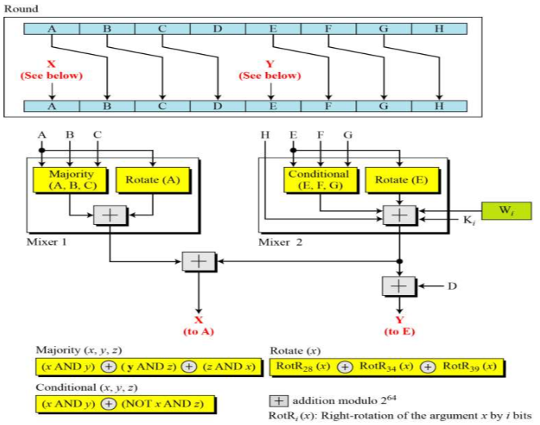
SHA-512 Round Function
Structure of each round in SHA-512

Slide 19
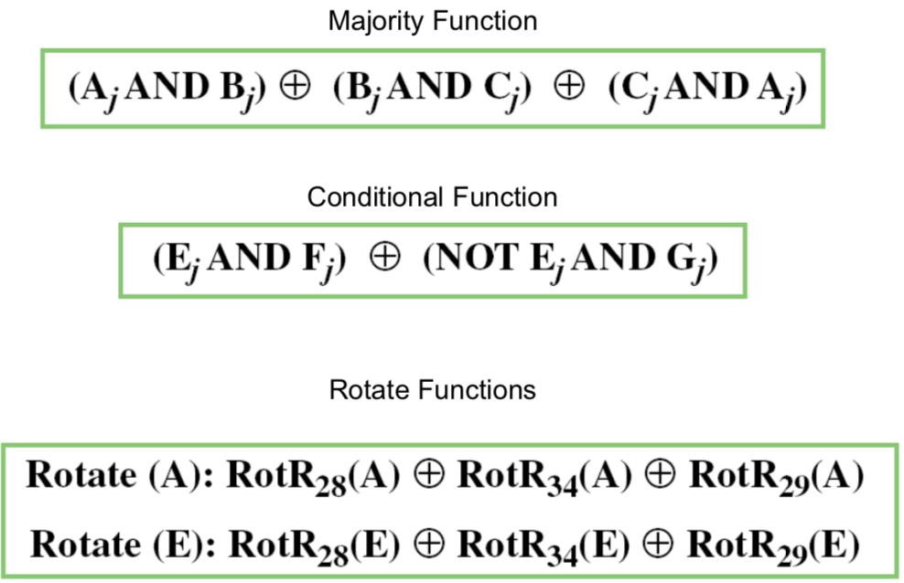
SHA-512 Round Function

Slide 20
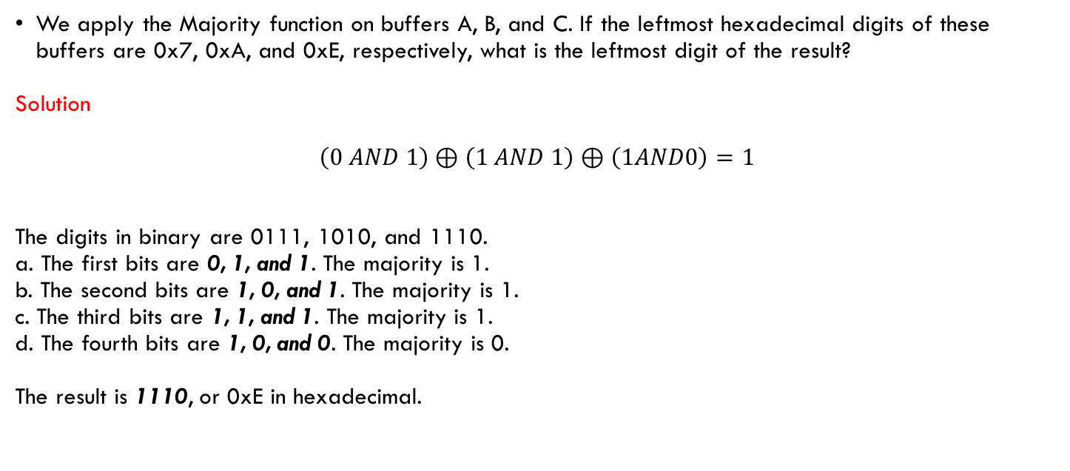
SHA-512 Majority Function calculation
We apply the Majority function on buffers A, B, and C. If the leftmost hexadecimal digits of these buffers are 0x7, 0xA, and 0xE, respectively, what is the leftmost digit of the result?
Solution
$$\left(0 AND 1\right)⊕\left(1 AND 1\right)⊕\left(1AND0\right)=1$$
The digits in binary are 0111, 1010, and 1110.
a. The first bits are 0, 1, and 1. The majority is 1.
b. The second bits are 1, 0, and 1. The majority is 1.
c. The third bits are 1, 1, and 1. The majority is 1.
d. The fourth bits are 1, 0, and 0. The majority is 0.
The result is 1110, or 0xE in hexadecimal.

Slide 21

SHA-512 Conditional Function calculation
We apply the Conditional function on E, F, and G buffers. If the leftmost hexadecimal digits of these buffers are 0x9, 0xA, and 0xF respectively, what is the leftmost digit of the result?
Solution
$$\left(1 AND 1\right)⊕\left(NOT 1 AND 1\right)=1$$
The digits in binary are 1001, 1010, and 1111.
The first bits are 1, 1,and 1.The result is F1, which is 1.
The second bits are 0,0, and 1. The result is G2, which is 1.
The third bits are 0,1,and 1.The result is G3, which is 1.
The fourth bits are 1,0,and 1.The result is F4, which is 0.
The result is 1110, or 0xE in hexadecimal.

Slide 22
Example using SHA-512
ASCII characters: “abc”, which is equivalent to the following 24-bit binary string:
01100001 01100010 01100011 = 616263 in Hexadecimal
The original length is 24 bits, or a hexadecimal value of 18. the 1024-bit message block, in hexadecimal, is
6162638000000000 0000000000000000 0000000000000000 0000000000000000 0000000000000000 0000000000000000 0000000000000000 0000000000000000 0000000000000000 0000000000000000 0000000000000000 0000000000000000 0000000000000000 0000000000000000 0000000000000000 0000000000000018
W0 = 6162638000000000 W1 = 0000000000000000 W2 = 0000000000000000 W3 = 0000000000000000
W4 = 0000000000000000 W10 = 0000000000000000 W11 = 0000000000000000 W12 = 0000000000000000
W5 = 0000000000000000 W6 = 0000000000000000 W7 = 0000000000000000 W8 = 0000000000000000 W9 = 0000000000000000 W13 = 0000000000000000
W14 = 0000000000000000 W15 = 0000000000000018

Slide 23
References
Network Security Essentials: Applications and Standards, 4th Edition by William Stallings
Introduction to Cryptography with Coding Theory (2nd Edition) by Wade Trappe Lawrence C. Washington(2005-07-25)
Online sources:
https://www.youtube.com/watch?v=Fr2fQlQIokY
https://www.youtube.com/watch?v=VtHSyoJkDXw
https://www.youtube.com/watch?v=JViXozmJnSk
https://www.thesslstore.com/blog/what-is-a-hash-function-in-cryptography-a-beginners-guide/
http://sconce.ics.uci.edu/134-S11/LEC6.pdf
https://www.sanfoundry.com/cryptography-questions-answers-secure-hash-algorithms-i/
https://www.rapidtables.com/convert/number/decimal-to-hex.html

Slide 24

Thanks for your attention !

